Slide 1




PS ID: OI-10
PS Title: Custom Collaboration Platform for Students and Startups
Powered by:
Team Name: HyperScript Surge
Team Leader Name: Arjun Singh Institution Name: Vidyalankar Polytechnic
Segment: Open Innovation

Slide 2
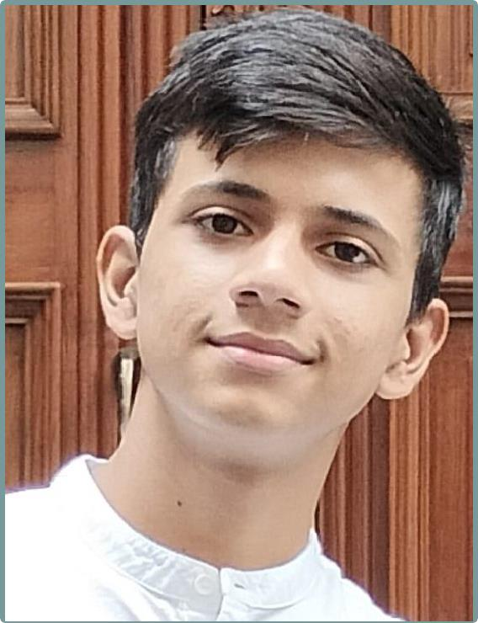

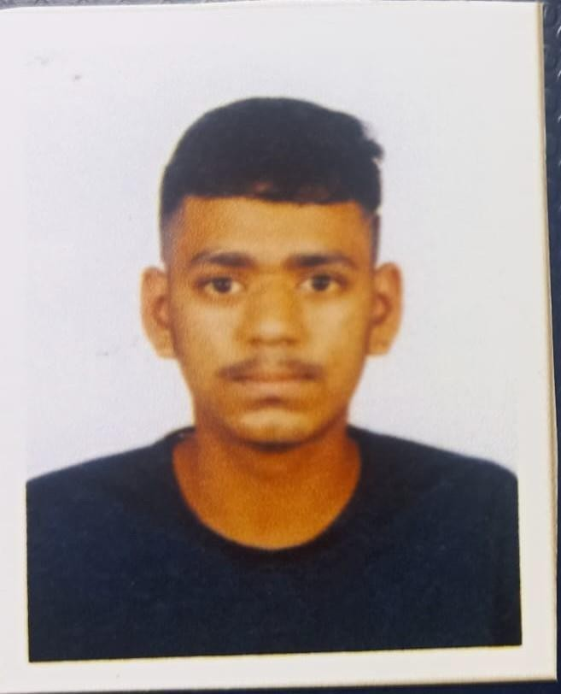
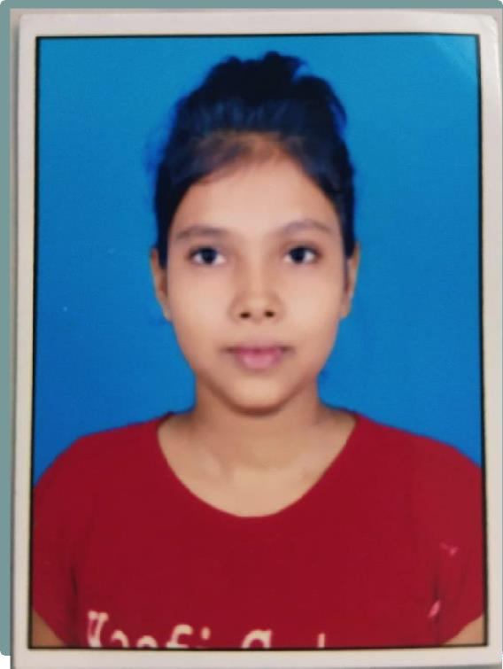
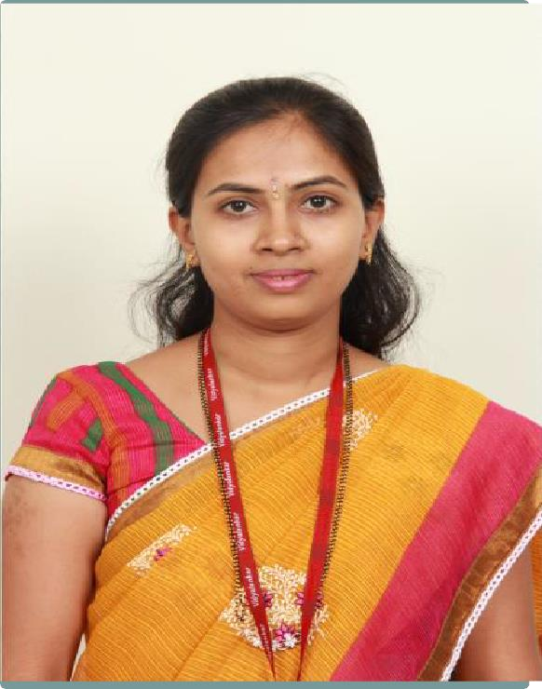
Meet the Team
Team Leader
Team Member 1
Team Member 2
Team Member 3
Institute Mentor

Slide 3
IDEA/ APPROACHDETAILS
Students struggle to find relevant and engaging project ideas for their final year.
Startups face challenges in finding talented students to help solve their real- world problems.
Innovative Solutions we can provide:
- A web application where startups can post their problem statements in a standardized format. Students can browse and understand these problem statements and propose solutions by sending a "pull request" to the company.
The collaboration is based on a letter of recommendation or acknowledgment from the company, rather than monetary compensation.

Slide 4
TECHNOLOGYSTACK
Technologies to be used :
Frontend-
Web : Nextjs and certain libraries for building UI.
Backend-
Node.js with Express.js for handling form submissions, and managing the review process.
Database-
MongoDB: To store all data related to proposals, user profiles, and agreement documents.

Slide 5
USPsOF YOURIDEA
Bridging the Gap Between Startups and Students: Startups face difficulties finding fresh talent, and students struggle to get meaningful, real-world projects. Our platform directly connects these two groups, creating a mutual benefit.
Non-Monetary Collaboration: The focus on recommendations or acknowledgment from startups, rather than monetary compensation, allows for a unique, non-financial relationship that can be more appealing to startups and educational for students.
Streamlined Solution Submission via Pull Request System: This system allows students to propose solutions in a way that mimics real- world software development practices, helping them gain hands-on experience.

Slide 6
FUTURESCOPE
Enhanced Collaboration Tools: Integrate collaboration tools such as chat systems, video conferencing, and shared workspaces for better communication between students and startups.
Project Showcasing for Students: Allow students to showcase completed projects on their profiles, which they can share with future employers, acting as a portfolio of their work.
Gamification: Introduce gamification elements such as leaderboards, challenges, and rewards for students, which would increase engagement and motivate them to participate more actively.

Slide 7
DEPENDENCIES/ SHOW STOPPER
Low User Engagement:
Without a sufficient number of startups posting problems or students submitting solutions, the platform may fail to serve its purpose, becoming inactive.
Technological Failures:
Bugs or failures in the frontend (React.js) or backend (Node.js) code could block users from using the platform’s core features, such as submitting problem statements or proposals.
User Base:
You’ll rely on active participation from both startups and students for the platform to be successful. Getting both parties engaged and ensuring they use the platform effectively is crucial.

Slide 8
Features of Solution
Simplified Collaboration : A platform that bridges the gap between startups and students, facilitating mutual benefits through meaningful projects.
Problem Statement Posting : Startups can post real-world problem statements in a structured format, accessible to students.
Proposal Submission and Feedback : Students can submit tailored proposals for problem statements and refine them based on feedback.
Non-Monetary Rewards : Focus on certificates, LORs, and portfolio building opportunities for students.
Role based dashboards : Separate dashboards for students and startups, ensuring streamlined and efficient interaction

Slide 9
Plan of action and Tasks Completed
Implement features for posting and managing problem statements.
Develop proposal submissions and review models
Set up progress tracking features.
Create intuitive interfaces for project tracking, dashboards etc.
Build interactive dashboards for students and startups
Conduct testing and deployment of the platform.
Tasks Completed :
Backend :
Authentication Module : Role based registration and login implemented for both startups and students.
Problem Statements : Module for startups to post and manage problem statement is functional. Also added startup email validation using a npm package for legitimacy of startups
Frontend : Landing Home page designed with the best possible UI. Signup and Login Pages : Completed for both startups and students.

Slide 10
Team Members
Powered by:
 | Name | Gender
Team Leader | Arjun Singh | Male
Team Member 1 | Priya Tiwari | Female
Team Member 2 | Daksh Patel | Male
Team Member 3 | Vaishnavi Javir | Female

